Slide 1
Computer Architecture
A Quantitative Approach
Chapter 5
Multiprocessors

Slide 2
Outline
Coherence
Write Consistency
Snooping
Building Blocks
Snooping protocols and examples
Coherence traffic and Performance on MP
Directory-based protocols and examples
Conclusion

Slide 3
DIRECTORY BASED PROTOCOL

Slide 4
Scalable Approach: Directories
Every memory block has associated directory information
  directory keeps track of copies of cached blocks and their states
  on a miss, find directory entry, look it up, and communicate only with the nodes that have copies, if necessary to communicate at all
  in scalable networks, communication with directory and copies is through network transactions
Many alternatives for organizing directory information

Slide 5

Basic Operation of Directory
P
P
k processors (or k bussed, snoopy nodes)
With each cache-block in memory: k presence-bits p[i], 1 dirty-bit
With each cache-block in cache:
1 valid bit, and 1 dirty (owner) bit
Cache
Cache
Interconnection Network
•
Memory Directory
•
•
presence bits dirty bit
Read from main memory by processor i:
  If memory dirty-bit OFF then { read from main memory; turn p[i] ON }
  If mem_dirty-bit ON then { recall line from dirty proc (cache state to shared); update memory; turn dirty-bit OFF; turn p[i] ON; supply recalled data to i}
Write to main memory by processor i:
  If mem_dirty-bit OFF then { supply data to i; send invalidations to all caches that have the block, where p[j] ON=>OFF; turn dirty-bit ON; turn p[i] ON }
  If mem_dirty-bit ON then { recall line from dirty proc (cache state to invalid); update memory; supply recalled data to i; send invalidations to all caches that have the block, where p[j] ON=>OFF; leave dirty-bit ON; turn p[i] ON }

Slide 6
Picture To Keep In Mind
P₁
Mem₁
P₂
Mem₂
…
$
$
Cost structure
  cache
  local memory
  remote memory
~2 cycles
~80 cycles
~200 cycles

Slide 7
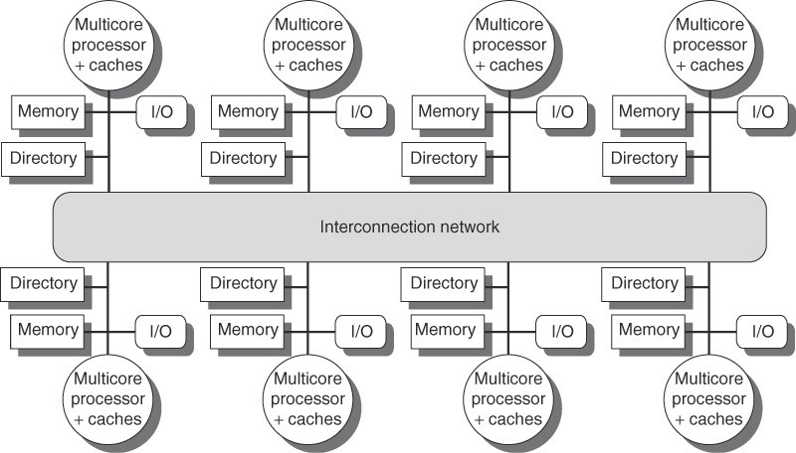
Directory in Distributed-Memory Multi-Processor

Slide 8
Directory Protocol
Similar to Snoopy Protocol: Three states in directory
  Shared: ≥ 1 processors have data, memory up-to-date
  Uncached only in memory; no processor has it;
  not valid in any cache
  Exclusive: 1 processor (owner) has data in its cache; or Dirty memory copy is out-of-date
In addition to cache state, directory must track which (multi-) processor(-node)s have data when in the shared state (usually bit vector p[], 1 if processor has copy)
Keep it simple(r):
  Writes to non-exclusive data ⇒ write miss
» Get exclusive access for making changes
  Processor blocks until access completes
  Assume messages received and acted upon in order sent

Slide 9
Directory Protocol
No bus and do not want to broadcast across network:
  shared interconnect no longer can act as a single arbitration point
  all messages must have explicit responses (handshakes)
Terms: typically 3 processors involved
  Local node where a request originates
  Home node where the memory location of an address resides
  Remote node which has a copy of a cache block, whether exclusive or shared
In the example messages on next slide:
  P = processor number
  A = address

Slide 10
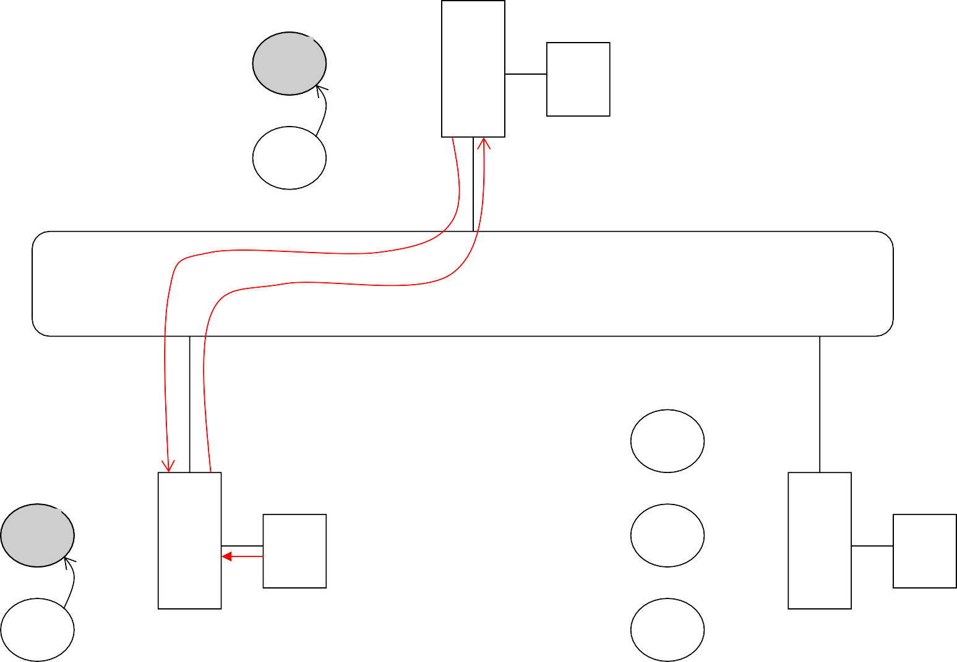
Example Directory Protocol (1st Read)
D
Read pA
S
Dir ctrl
P1: pA
S
R/reply
U
M
E
E
S
S
S
$
P1
$
P2
R/req
I
ld vA -> rd pA
{pA is page for addr vA}
I

Slide 11
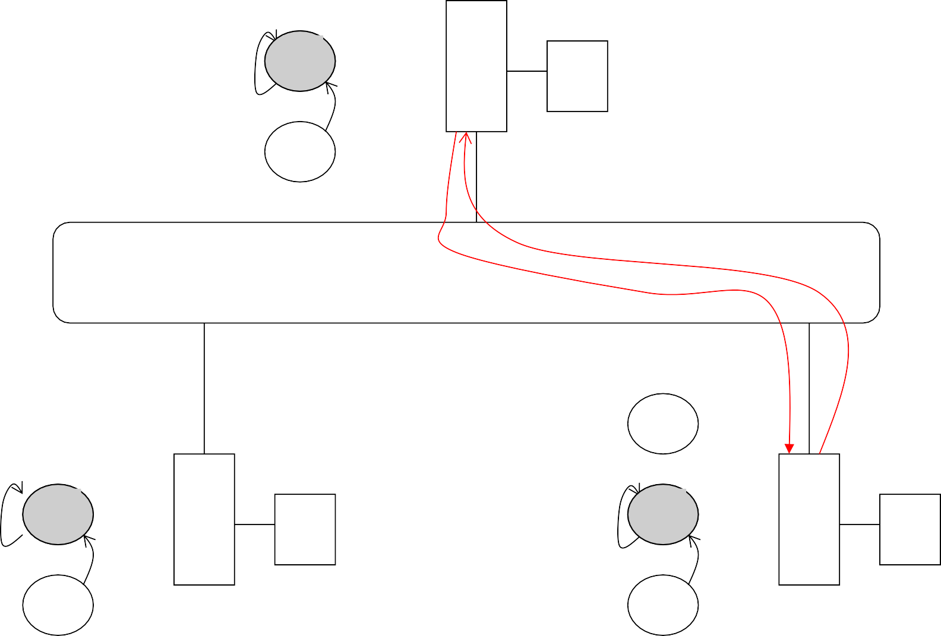
Example Directory Protocol (Read Share)
D
P1: pA P2: pA
S
R/_
S
Dir ctrl
M
R/reply
U
E
E
S
S
R/_
S
$
P1
R/_
S
$
P2
R/req
R/req
I
ld vA -> rd pA
I
ld vA -> rd pA

Slide 12
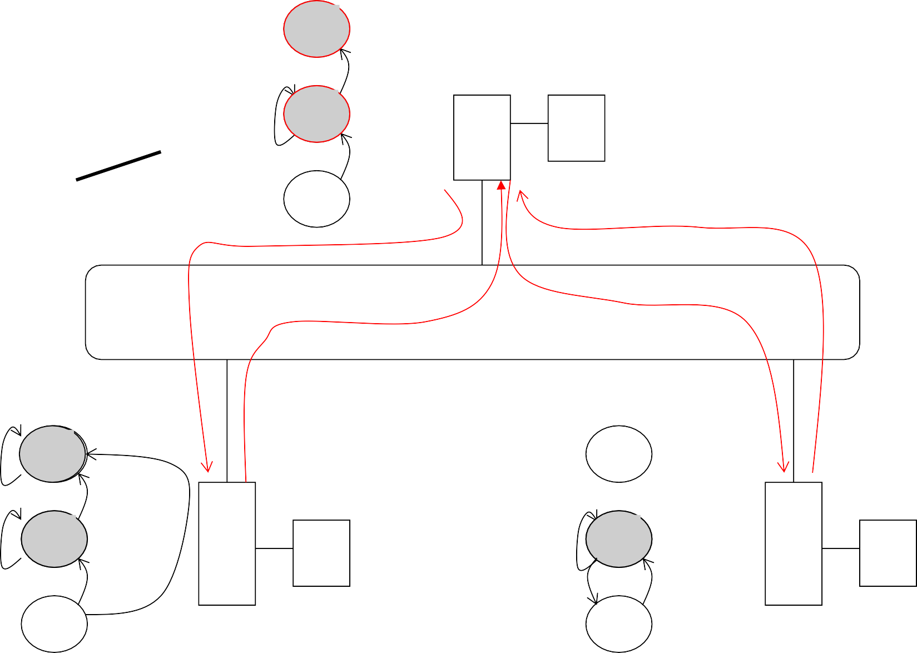
Example Directory Protocol (Write to shared)
D
D for dirty block, modified from memory copy RX/invalidate&reply
D
S
P1: pA EX
P2: pA
R/_
S
Dir M
ctrl
R/reply
U
Inv ACK
reply xD(pA)
Read_to_update pA
Invalidate pA
E
W/req E
E
W/_
E
W/req E
S
S
R/_
S
$
P1
R/_
Inv/_
S
$
P2
R/req
R/req
I
st vA -> wr pA
I

Slide 13
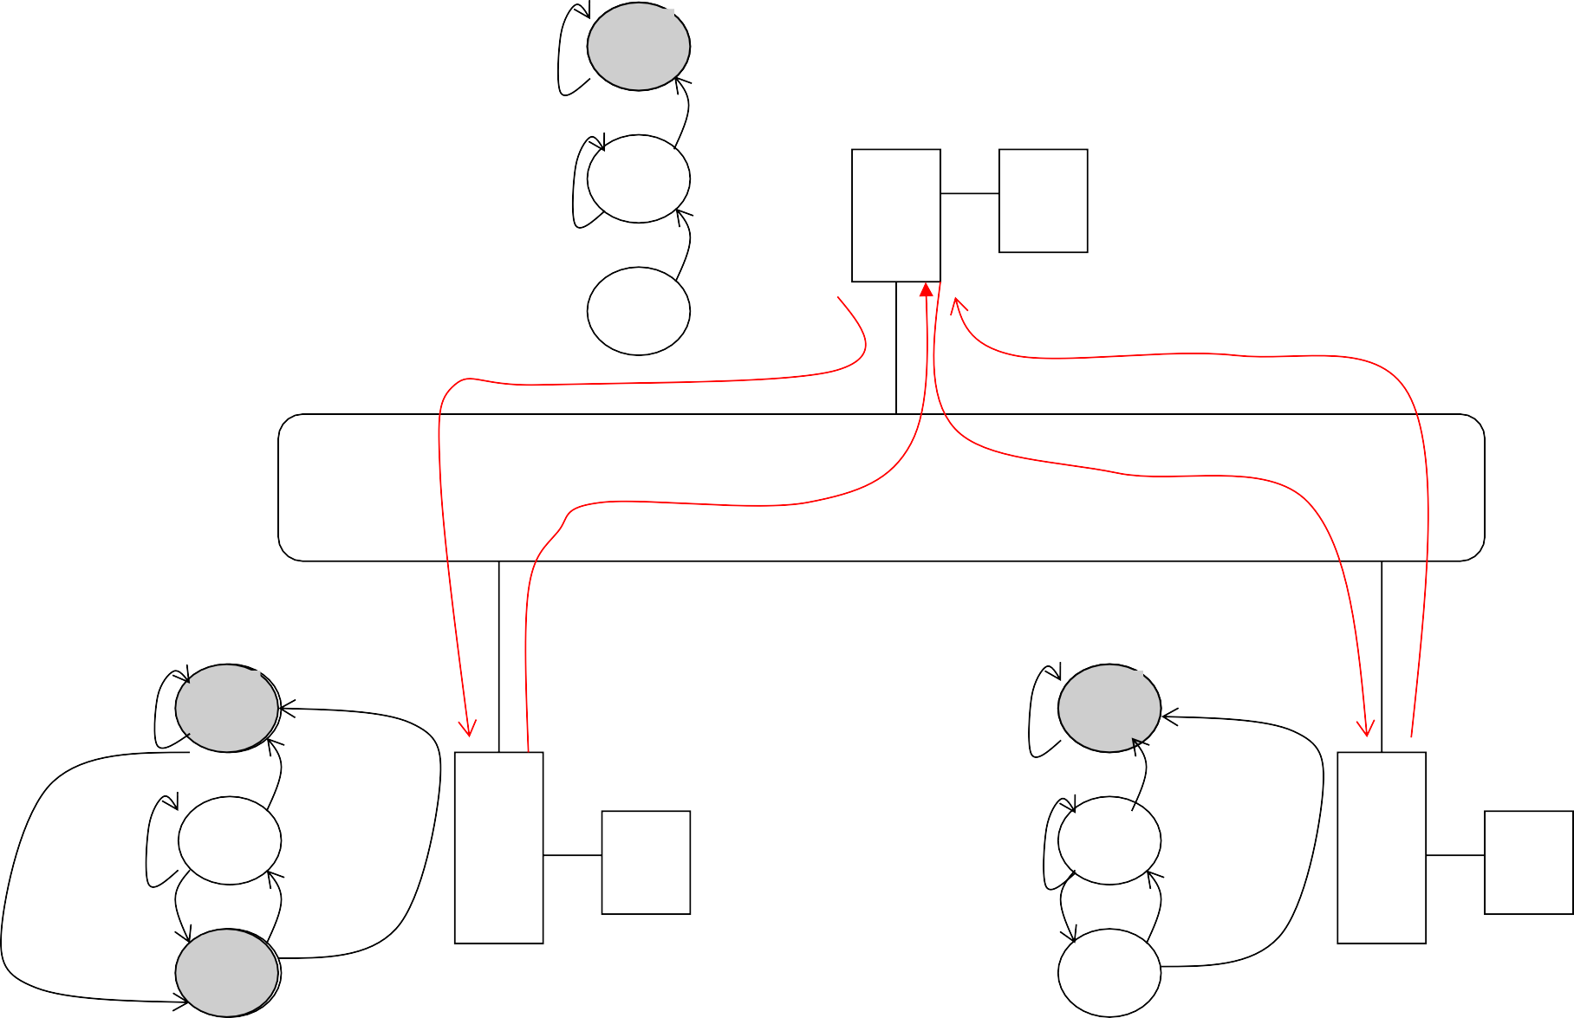
Example Directory Protocol (Write to Exclusive)
D
D for dirty block, modified from memory copy RX/invalidate&reply
RU/_
D
P2: pA EX
R/_
S
Dir M
ctrl
R/reply
U
Read_to_update pA
Inv pA
Write_back pA
Reply xD(pA)
E
W/req E
E
W/req E
W/_
E
W/_
E
W/req E
W/req E
R/_
S
R/_
Inv/_
S
$
P1
$
P2
Inv/_
R/req
R/req
I
I
I
st vA -> wr pA
Inv/_

Slide 14
Implementing a Directory
Assume operations atomic, but they are not; reality is much harder
Optimizations to lessen network traffic, latencies, or work done by home (directory) CPU to avoid bottleneck:
  For read-miss or write-miss of Exclusive cache block
» send data directly to requestor from owner, instead of owner sending to home for memory and then memory CPU sending data to requestor
» let directory send cache block owner id to requesting remote node and let requestor send message to owner to lessen work by directory
  For write-miss of Shared (= non-modified) block
» let directory send cache block value and list of sharing nodes to requestor and let requestor send invalidate requests to all nodes with a cache block copy to lessen work by directory

Slide 15

































Basic Directory Transactions To Let Remote CPU Do Much Coherency Work For Directory
Requestor
Requestor
1.
P
1.
P
RdEx request
C
Read request to directory
to directory
C
A
M/D
Directory node for block
A
M/D
2.
P
Reply with sharers identity
C
2.
M/D
Reply with owner identity
P
A
3.
C
Read req. to owner
M/D
3a.
3 b.
Directorynode
A
Inval. req. to sharer
Inval. req. to sharer
4a.
Data
4a.
4 b.
Reply
Inval. ack
Inval. ack
4 b.
Revision message to directory
P
P
P
C
C
C
A
M/D
A
M/D
A
M/D
Node with
dirty copy
(a) Read miss to a block in dirty state
Sharer
Sharer
(b) Write miss to a block with two sharers

Slide 16
State Transition Diagram for One Block
States identical to snoopy case; transactions very similar.
Transitions caused by read misses, write misses, invalidates, data fetch requests
Generates read miss & write miss message to home directory.
Write misses that were broadcast on the bus for snooping => explicit invalidate & data fetch requests.
Note: on a write, a cache block is bigger, so need to read the full cache block – write allocate

Slide 17


CPU-Cache State Machine
CPU Read hit
State machine for CPU requests for each memory block
Invalid state if in memory
Invalidate
Shared (read/only)
Invalid
CPU Read
Send Read Miss message
CPU read miss: Send Read Miss
CPU Write: Send Write Miss msg to h.d.
CPU Write: Send Write Miss message to home directory
Fetch/Invalidate send Data Write Back message
to home directory
Fetch: send Data Write Back message to home directory
CPU read miss: send Data
Write Back message and read miss to home directory
CPU write miss:
send Data Write Back message and Write Miss to home directory
Exclusive (read/write)
CPU read hit CPU write hit

Slide 18
State Transition Diagram for Directory
Same states & structure as the transition diagram for an individual cache
2 actions: update of directory state & send messages to satisfy requests
Tracks all copies of memory block
Also indicates an action that updates the sharing set, Sharers, as well as sending a message

Slide 19
Example Directory Protocol
Message sent to directory causes two actions:
  Update the directory
  More messages to satisfy request
Block is in Uncached state: the copy in memory is the current value; only possible requests for that block are:
  Read miss: requesting processor sent data from memory &requestor made only sharing node; state of block made Shared.
  Write miss: requesting processor is sent the value & becomes the Sharing node. The block is made Exclusive to indicate that the only valid copy is cached. Sharers indicates the identity of the owner.
Block is Shared => the memory value is up-to-date:
  Read miss: requesting processor is sent back the data from memory & requesting processor is added to the sharing set.
  Write miss: requesting processor is sent the value. All processors in the set Sharers are sent invalidate messages, & Sharers is set to identity of requesting processor. The state of the block is made Exclusive.

Slide 20
Example Directory Protocol
Block is Exclusive: current value of the block is held in the cache of the processor identified by the set Sharers (the owner) => three possible directory requests:
  Read miss: owner processor sent data fetch message, causing state of block in owner’s cache to transition to Shared and causes owner to send data to directory, where it is written to memory & sent back to requesting processor.
Identity of requesting processor is added to set Sharers, which still contains the identity of the processor that was the owner (since it still has a readable copy). State is shared.
  Data write-back: owner processor is replacing the block and hence must write it back, making memory copy up-to-date (the home directory essentially becomes the owner), the block is now Uncached, and the Sharer set is empty.
  Write miss: block has a new owner. A message is sent to old owner causing the cache to send the value of the block to the directory from which it is sent to the requesting processor, which becomes the new owner. Sharers is set to identity of new owner, and state of block is made Exclusive.

Slide 21
Directory State Machine
Read miss: Sharers += {P};
State machine
for Directory requests for each
memory block
Read miss: Sharers = {P} send Data Value Reply
send Data Value Reply
Shared (read only)
Uncached state if in memory
Uncached
Write Miss: Sharers = {P}; send Data Value Reply msg
Write Miss: send Invalidate to Sharers;
then Sharers = {P}; send Data Value Reply msg
Data Write Back: Sharers = {} (Write back block)
Write Miss: Sharers = {P};
send Fetch/Invalidate; send Data Value Reply msg to remote cache
Read miss: Sharers += {P}; send Fetch;
send Data Value Reply msg to remote cache (Write back block)
Exclusive (read/write)

Slide 22
Example
Processor 1 Processor 2
Interconnect
Directory
Memory
 | P1 |  |  | P2 |  |  | Bus |  |  |  | Directory |  |  | Memor
step | State | Addr | Value | Stat | Add | Value | Actio | Proc. | Addr | Value | Addr | State | {Procs | Value
P1: Write 10 to A1
P1: Read A1
P2: Read A1
P2: Write 20 to A1
P2: Write 40 to A2
A1 and A2 map to the same cache block

Slide 23
Example
Processor 1 Processor 2
Interconnect
Directory
Memory
 | P1 |  |  | P2 |  |  | Bus |  |  |  | Directory |  |  | Memor
step | State | Addr | Value | Stat | Add | Value | Actio | Proc. | Addr | Value | Addr | State | {Procs | Value
P1: Write 10 to A1 |  |  |  |  |  | WrMs |  | P1 | A1 |  | A1 | Ex | {P1}
Excl. |  | A1 | 10 |  |  |  | DaRp | P1 | A1 | 0
P1: Read A1
P2: Read A1
P2: Write 20 to A1
P2: Write 40 to A2
A1 and A2 map to the same cache block

Slide 24
Example
Processor 1 Processor 2
Interconnect
Directory
Memory
 | P1 |  |  | P2 |  |  | Bus |  |  |  | Directory |  |  | Memor
step | State | Addr | Value | Stat | Add | Value | Actio | Proc. | Addr | Value | Addr | State | {Procs | Value
P1: Write 10 to A1 |  |  |  |  |  | WrMs |  | P1 | A1 |  | A1 | Ex | {P1}
Excl. |  | A1 | 10 |  |  |  | DaRp | P1 | A1 | 0
P1: Read A1 | Excl. | A1 | 10
P2: Read A1
P2: Write 20 to A1
P2: Write 40 to A2
A1 and A2 map to the same cache block

Slide 25

Example
Processor 1 Processor 2
Interconnect
Directory
Memory
 | P1 |  |  | P2 |  |  | Bus |  |  |  | Directory |  |  |  | Memor
step | State | Addr | Value | Stat | Add | Value | Actio | Proc. | Addr | Value | Addr | State | {Procs |  | Value
P1: Write 10 to A1 |  |  |  |  |  | WrMs |  | P1 | A1 |  | A1 | Ex | {P1}
Excl. |  | A1 | 10 |  |  |  | DaRp | P1 | A1 | 0
P1: Read A1 | Excl. | A1 | 10
P2: Read A1 |  |  | Shar. |  | A1 |  | RdMs | P2 | A1
Shar. |  | A1 | 10 |  |  |  | Ftch | P1 | A1 | 10 | A1 |  |  |  | 10
 |  |  |  | Shar. | A1 | 10 | DaRp | P2 | A1 | 10 | A1 Sh | ar. | P1,P2} |  | 10
P2: Write 20 to A1
P2: Write 40 to A2
A1
10
10
10
Write Back
A1 and A2 map to the same cache block

Slide 26
Example
Processor 1 Processor 2
Interconnect
Directory
Memory
 | P1 |  |  | P2 |  |  | Bus |  |  |  | Directory |  |  |  | Memor
step | State | Addr | Value | Stat | Add | Value | Actio | Proc. | Addr | Value | Addr | State | {Procs |  | Value
P1: Write 10 to A1 |  |  |  |  |  | WrMs |  | P1 | A1 |  | A1 | Ex | {P1}
Excl. |  | A1 | 10 |  |  |  | DaRp | P1 | A1 | 0
P1: Read A1 | Excl. | A1 | 10
P2: Read A1 |  |  | Shar. |  | A1 |  | RdMs | P2 | A1
Shar. |  | A1 | 10 |  |  |  | Ftch | P1 | A1 | 10 | A1 |  |  |  | 10
 |  |  |  | Shar. | A1 | 10 | DaRp | P2 | A1 | 10 | A1 Sh | ar. | P1,P2} |  | 10
P2: Write 20 to A1 |  |  |  | Excl. | A1 | 20 | WrMs | P2 | A1 |  |  |  |  |  | 10
 | Inv. |  |  |  |  | Inval. |  | P1 | A1 |  | A1 | Excl. | {P2} |  | 10
P2: Write 40 to A2
A1
10
A1 and A2 map to the same cache block

Slide 27
Example
Processor 1 Processor 2
Interconnect
Directory
Memory
 | P1 |  |  | P2 |  |  | Bus |  |  |  | Directory |  |  |  | Memor
step | State | Addr | Value | Stat | Add | Value | Actio | Proc. | Addr | Value | Addr | State | {Procs |  | Value
P1: Write 10 to A1 |  |  |  |  |  | WrMs |  | P1 | A1 |  | A1 | Ex | {P1}
Excl. |  | A1 | 10 |  |  |  | DaRp | P1 | A1 | 0
P1: Read A1 | Excl. | A1 | 10
P2: Read A1 |  |  | Shar. |  | A1 |  | RdMs | P2 | A1
Shar. |  | A1 | 10 |  |  |  | Ftch | P1 | A1 | 10 | A1 |  |  |  | 10
 |  |  |  | Shar. | A1 | 10 | DaRp | P2 | A1 | 10 | A1 Sh | ar. | P1,P2} |  | 10
P2: Write 20 to A1 |  |  |  | Excl. | A1 | 20 | WrMs | P2 | A1 |  |  |  |  |  | 10
 | Inv. |  |  |  |  | Inval. |  | P1 | A1 |  | A1 | Excl. | {P2} |  | 10
P2: Write 40 to A2 |  |  |  |  |  | WrMs |  | P2 | A2 |  | A2 | Excl. | {P2} |  | 0
 |  |  |  |  |  | WrBk |  | P2 | A1 | 20 | A1 Un | ca. | {} |  | 20
 |  |  |  | Excl. | A2 | 40 | DaRp | P2 | A2 | 0 | A2 | Excl. | {P2} |  | 0
A1
A1 and A2 map to the same cache block

Slide 28
A Popular Middle Ground
Two-level “hierarchy”
Individual nodes are multiprocessors, connected non- hierarchically
  e.g. mesh of (bussed) SMPs
Coherence among nodes is directory-based
  directory keeps track of nodes, not individual processors
Coherence within nodes is snooping (or directory)
  orthogonal, but needs a good interface for functionality

Slide 29
And in Conclusion …
Caches contain all information on state of cached memory blocks
Snooping cache over shared medium for smaller MP by invalidating other cached copies on write
Sharing cached data ⇒ Coherence (values returned by a read), Consistency (when a written value will be returned by a read)
Snooping and Directory Protocols are similar; bus makes snooping easier because of broadcast (snooping => uniform memory access)
Directory has extra data structure to keep track of state of all cache blocks
Distributing directory => scalable shared address space multiprocessor => Cache coherent, Non uniform memory access
29

Slide 30
Performance of Symmetric Shared-Memory MPs
Cache performance is combination of
  Uniprocessor cache miss traffic
  Traffic caused by communication
» Results in invalidations and subsequent cache misses
4th C: coherency miss
  Joins Compulsory, Capacity, Conflict

Slide 31
Coherency Misses
True sharing misses arise from the communication of data through the cache coherence mechanism
  Invalidates due to 1st write to shared block
  Reads by another CPU of the modified block in different cache
  Miss would still occur if block size were 1 word
False sharing misses when a block is invalidated because some word in the block, other than the one being read, is written into
  Invalidation does not cause a new value to be communicated, but only causes an extra cache miss
  Block is shared, but no word in block is actually shared
⇒ miss would not occur if block size were 1 word

Slide 32
Example: True v. False Sharing v. Hit?
Assume x1 and x2 in same cache block but different words
P1 and P2 both read x1 and x2 before.
Time | P1 | P2 | True, False, Hit? Why?
1 | Write x1 |  | True miss; invalidate x1 in P2
2 |  | Read x2 | False miss; x1 irrelevant to P2
3 | Write x1 |  | False miss; x1 irrelevant to P2
4 |  | Write x2 | False miss; x1 irrelevant to P2
5 | Read x2 |  | True miss; value was updated by P2

